Slide 1
COVID 19 Data Analysis process

Slide 2
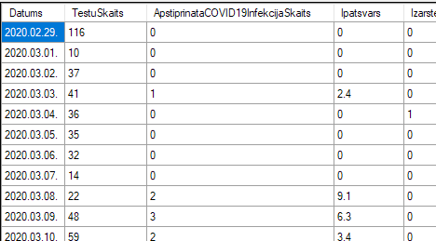
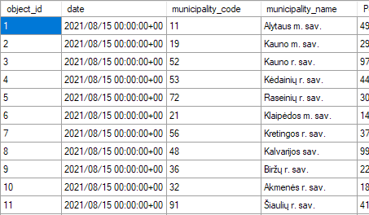
Data sources for Latvia and Lithuania
Latvijas Atvērto datu portāls
CSV File
https://data.gov.lv/lv
Oficialiosios statistikas portalos
CSV File
https://osp.stat.gov.lt

Slide 3
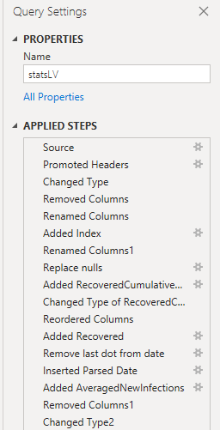
Data processing – using Power Query/M
Remove unnecessary data columns
Rename columns with standardized names
Add index columns to reference rows
Changed types of data in columns from mixed to whole/decimal number.
Parse dates (LT and LV have different date format in source file)
Add calculated column to provide daily number of recovered patients
Add 7 day rolling average for number of new infections to smooth out noise.
Extend dataset to provide future dates by merging with date table

Slide 4
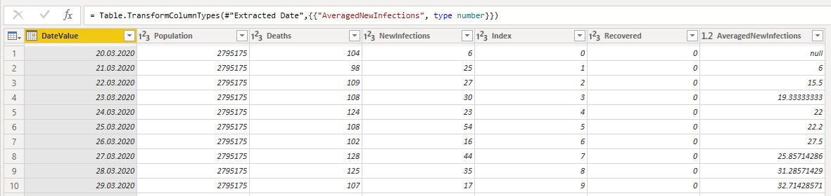
Data processing
Processed data sample:

Slide 5
Data processing
Power Query/M expression sample
List.Average(
Table.SelectRows(#"Inserted Parsed Date",
(rec) => ((rec[Index] >= [Index] - 7) and (rec[Index] < [Index])) )[NewInfections]
)
)

Slide 6
Data processing – LV specifics
Null values in place of numbers
Incomplete dataset – daily recovered

Slide 7
Data processing – LT specifics
More data then needed – per municipality numbers

Slide 8
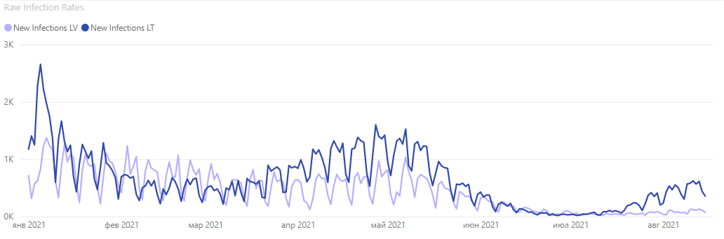
Visualizations and conclusions – Infection rates LV and LT
Raw data
High daily variability → more difficult to process

Slide 9
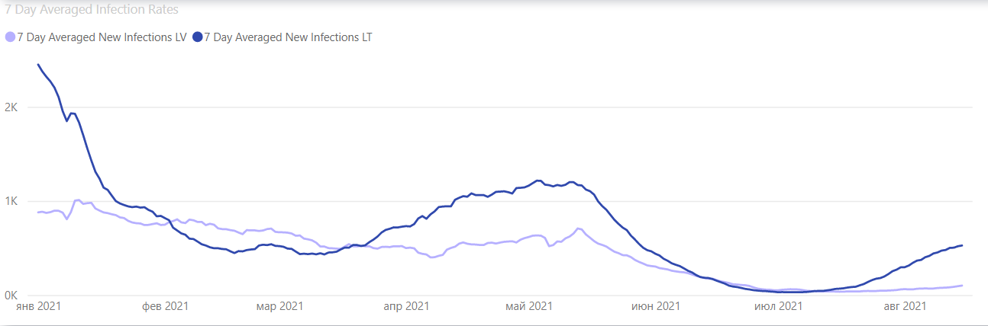
Vis&con – Infection rates LV and LT
7-day average
More clear trends

Slide 10
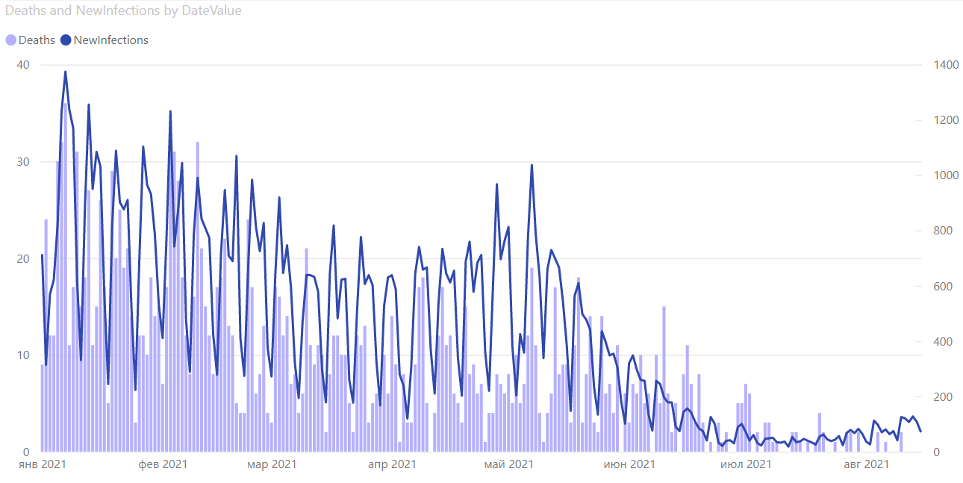
Vis&con - infection rates vs deaths in Latvia

Slide 11
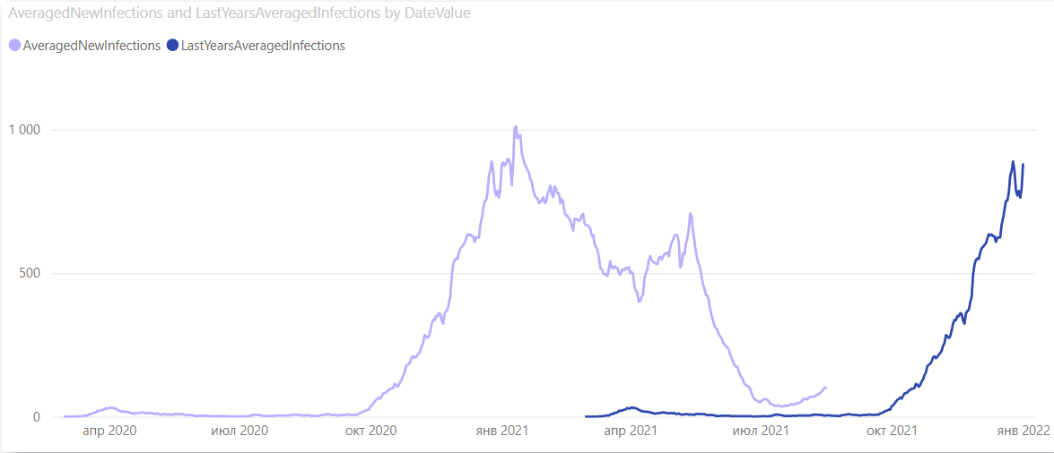
Vis&con - Forecasts
A very fallback chart

Slide 12
Vis&con – Forecasts – How it was supposed to be
Calculate same day virus spread coefficient for last year: k = NewInfections/NewInfectionsYesterday
Start applying k to last actual new infections data
Apply 7 day averaging and bring to chart

Slide 13
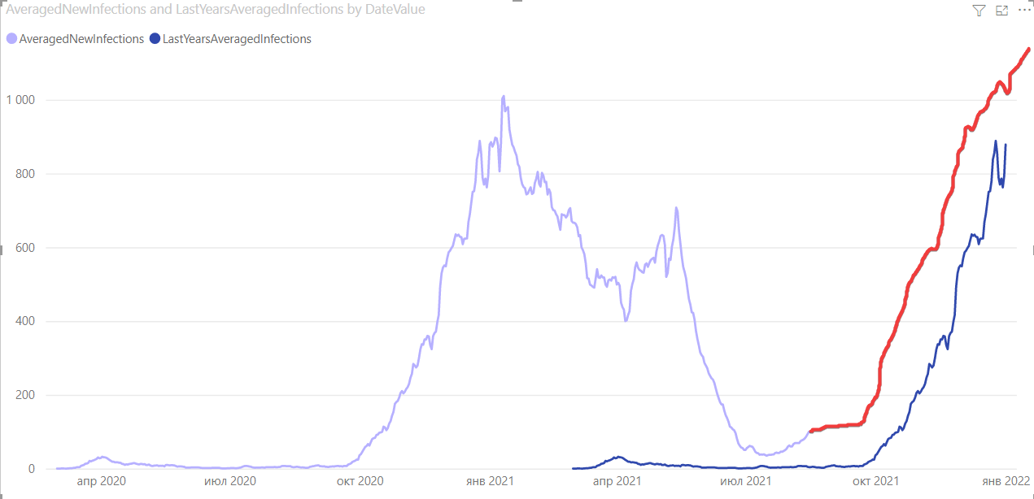
Vis&con – Forecasts – How it was supposed to be
*Simulated chart

